Slide 1
Dragonflies
By: Nolan Clavet, Ellen Wilkinson, Brady Martin

Slide 2
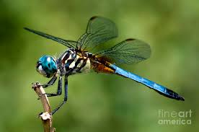
The dragonfly is on a stick

Slide 3
Dragonflies are:
Close cousins to damselflies. Dragonflies are big colorful insects.
Dragonflies are predators.
Dragonflies are called skimmers, darters ,chasers, and darning needles.
They eat other insects.

Slide 4
Dragonflies can:
Dragonflies can fly as fast as a car in town.
Dragonflies can have dark spots on their wings.
Dragonflies can hunt for food.

Slide 5
Dragonflies have:
Dragonflies have a head, thorax, abdomen, 6 legs, 4 wings, and compound eyes.

Slide 6
Dragonflies need:
Dragonflies need air, food, water, and space to survive.

Slide 7
Dragonflies eat:
Dragonflies eat plants, and other insects. For example, bees, mosquitoes, flies, and grasshoppers.

Slide 8
Dragonflies habitat:
Dragonflies live in ponds, lakes, and tall grass.

Slide 9
Life Cycle
First it is an egg. Then it hatches into a nymph. Next the nymph gets bigger. Last they are an adult.

Slide 10
Fun Facts
Dragonflies can fly as fast as a car in town. When a dragonflies eggs hatch they are not larva it is a nymph! They look like a very small version of the adult dragonfly!

Slide 11
Sources:
Dragonflies - By Molly McLaughlin
Dragonflies - By Mari Schuh
Dragonflies - By Jason Cooper

