Slide 1
Butterflies
By: Madison Newett, Emma Adams, Charles Safford

Slide 2
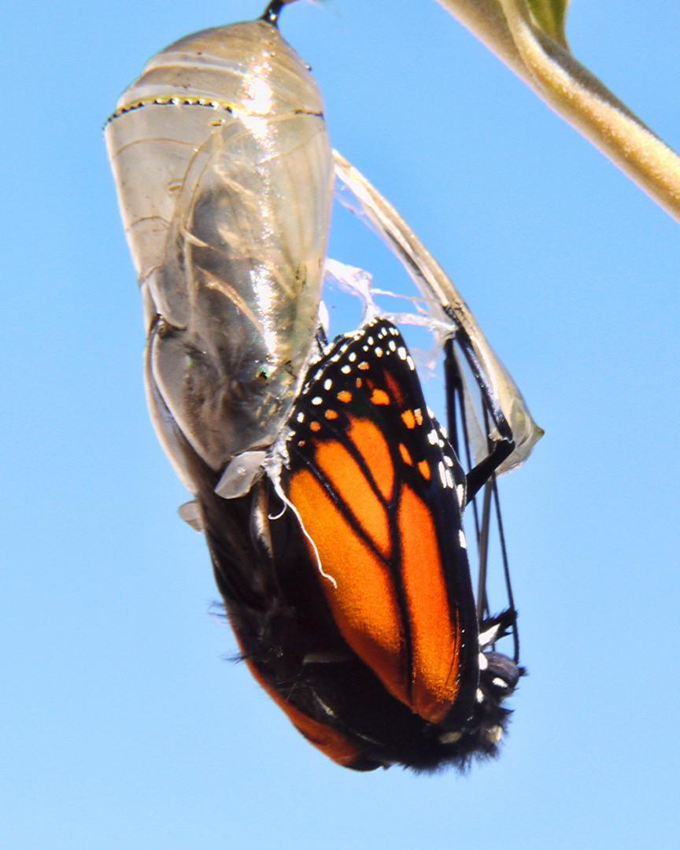
The butterfly is coming out of its pupa.

Slide 3
Butterflies are:
-A lot of colors
-Pollinators
-Insects

Slide 4
Butterflies can:
Migrate
Fly
Pollinate
Eat plants
Use their feelers to taste and smell things
UUUUUUUUUUUUU

Slide 5
Butterflies have:
Butterflies have wings . They have six legs. They have a head and thorax and abdomen .Butterflies also antennae and a tongue.

Slide 6
Butterflies need:
Butterflies need water,food, air,and space also flowers and plants too.

Slide 7
Butterfly food
Butterflies eat flowers and plants and leaves.

Slide 8
Butterflies Habitat
Butterflies live in caves,gardens,forests and grasslands.
They live in Africa, trees and they live everywhere except Antarctica.

Slide 9
Butterflies life cycle
A butterfly starts as an egg.
Then it hatches and it is a larva, it stops eating and changes into a pupa.
It comes out of the cocoon and is a butterfly.

Slide 10
Fun facts
Monarch caterpillars and butterflies are poisonous to many animals.
The Monarch butterflies spend the winter in Mexico where it is warm.

Slide 11
Sources
Migrating with the Monarch Butterfly by Thessaly Catt
2. Butterflies by Donna Bailey
3. I see a Butterfly by Alex Appleby

